Slide 1
Neeley Analytics Initiative 2022 Analytics Academy
Designing an Effective Dashboard for Business
Justin B. Keeler
July 21st, 2022

Slide 2

Agenda
Demonstrative Format
5 Key Topics
Audience/Needs
Appropriate Visualization
Understandable/Interpretable
Effective Labeling
Interactive Dashboards
Summary

Slide 3
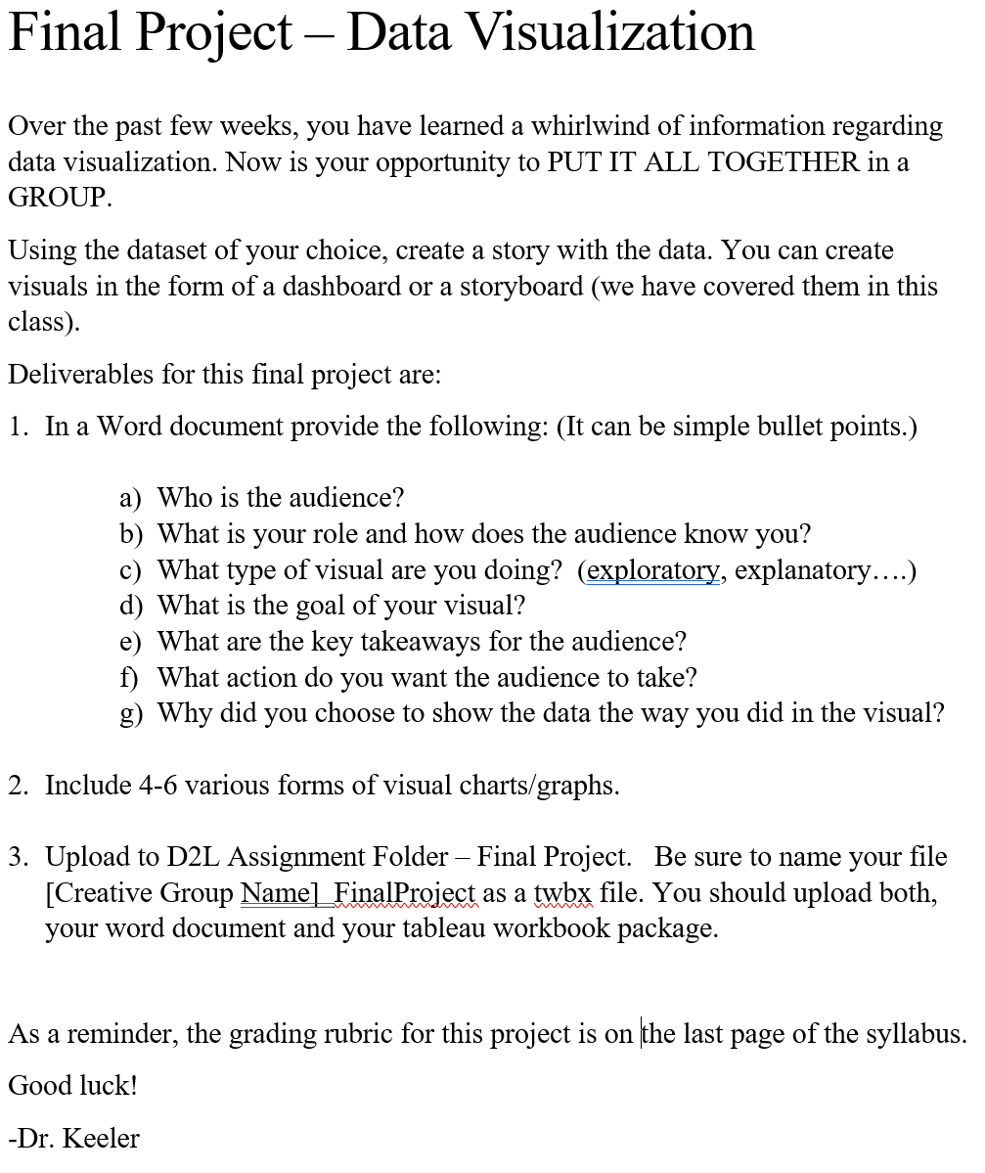
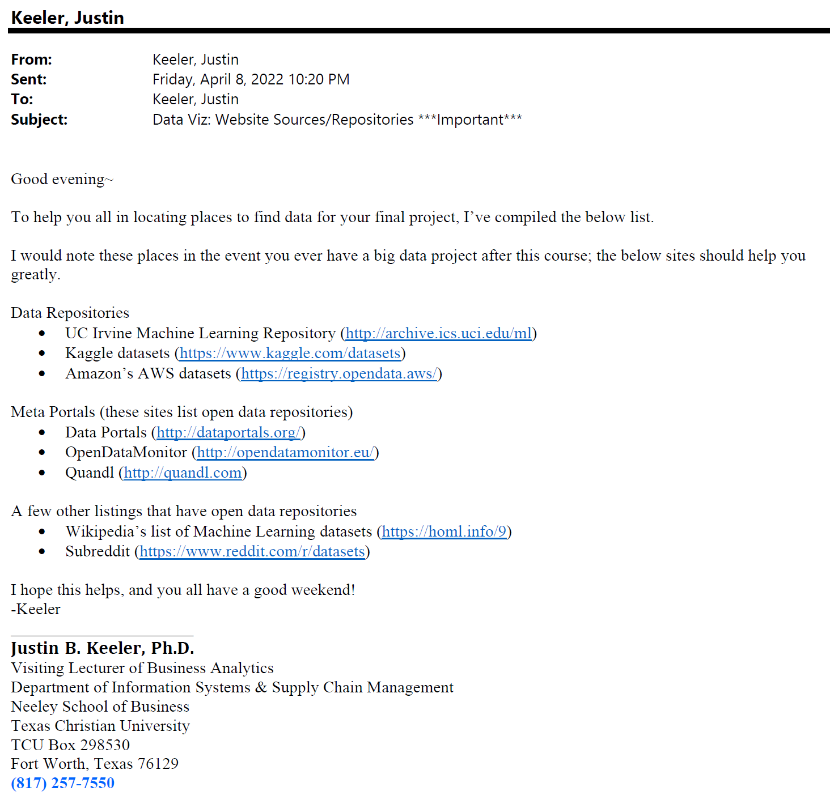
Presentation Format Key Points Oriented & Integrated Examples (Student Projects)
Focus on five key topics while leveraging my teaching experience in analytics and data visualization.
Each key topic will have several points, these will be expanded on in varying degrees of detail.
Examples are from my data visualization/analytics course where I taught and guided students in their final projects.

Slide 4
Knowing the audience, their needs, and planning Key Points
Think of the audience as a customer!
What information and utility does the audience expect from your product?
The audience desires to learn and exercise actionable decision-making.
Architect the dashboard in a way that speaks to the audience.
What are the, “so what” questions being answered?
An interactive dashboard should communicate information that allows the audience to better understand complex data patterns via analytics.
Business is dynamic; anticipate audience needs to change and evolve!
How will what is current and relevant today in the dashboard continue?
The clearest answer is the practice of understanding data and usage of analytic techniques will change over time! Be mindful of this.
Takeaways
The Who: Be specific to the audience to engage them. This is critical!
The What: Know the capabilities and limitations of analytics that can be
provided for the audience.
The Why: The extent of actions the audience need to take? Consider their
knowledge of the data or lack of familiarization of it.
The How: How is the best way to communicate the information from the
analytics, narrated or non-narrated?

Slide 5
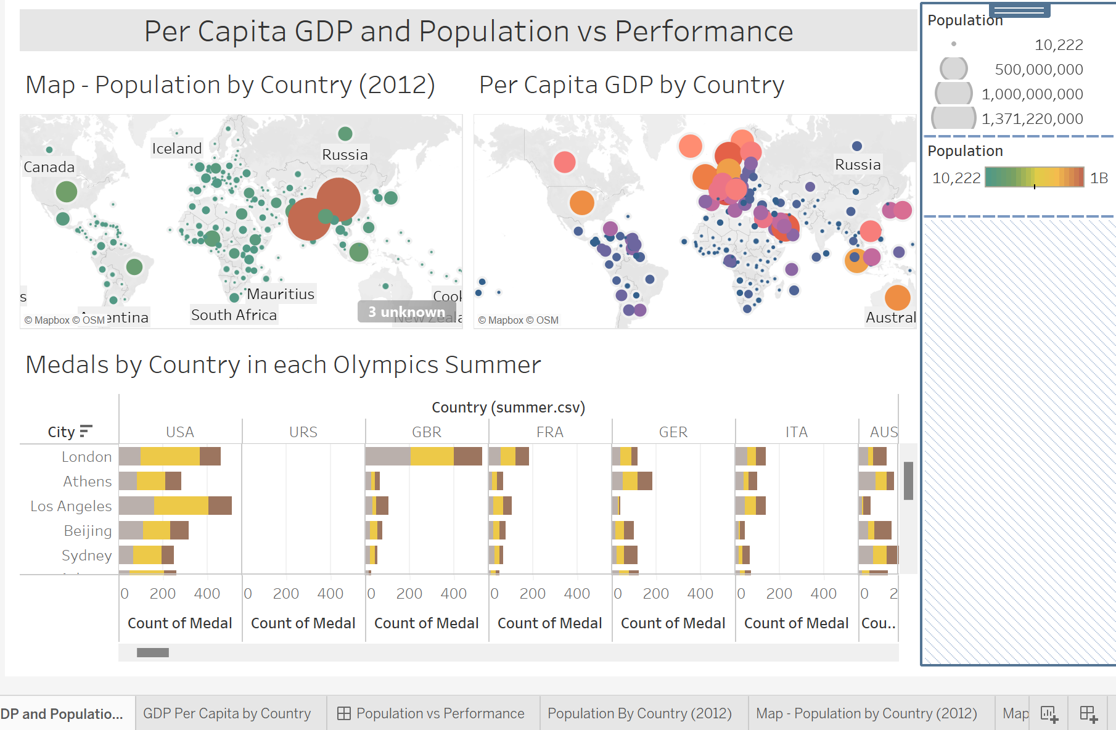
Knowing the audience, their needs, and planning! Illustrative Example
Audience/Needs/Planning Scenario:
The International Olympic Committee has hired NPPV Consulting to advise on the next location for the Summer Olympics
Evaluate whether location impacts performance
Assess a correlation between GDP, population, and performance
Conclusion:
Location appears to have a significant impact on performance
Population and GDP appear to affect performance. The major exception is India.

Slide 6
Selecting the right chart for data Key Points
Data type and story (question) determines the chart.
Why is it that these two factors are deciding factors in the visualization?
Continuous, Ordinal, and Nominal data, individually or in combinations explain/answer specific business questions.
What is the story?
Relationships? Change over time(trends)? Distributions? Comparisons? Part-to-whole composition? Geographical?
Think in terms of utility and tools…
Is it better to use a lug(torque) wrench to loosen bolts and change a tire or a torch?
Similar thinking relative to appropriate visualizing of statistic data, “data type” is a situation or circumstance, and visualization is the tool for describing and understanding data patterns to derive solutions.

Slide 7
Selecting the right chart for data Key Points
What is the data story message?
About relationships?
About trends?
About distribution(s)?
About comparing and contrasting?
Part-to-whole composition?
Scatter Plot
Area Chart
Histogram
Scatter Chart
Pie Chart
Line Chart
Line Chart
Boxplot
Line Chart
Donut Chart
Column Chart
KDE Plot
Column Chart
Stacked Column
Bar Chart
Stacked Bar

Slide 8

Keeping things simple and easy to understand Key Points
Avoid the temptation that there is a silver bullet in dashboards!
Think in terms of a focal area to holistically understand it better from multiple perspectives.
Simplicity with impact!
Parsimony and color usage
Example: Bar charts & scatter plots
Less is more!
We can learn from Google Analytics… a maximum of 12 widgets for a dashboard.
I didn’t have time to write a short letter, so I wrote a long one instead.
Mark Twain
In other words, prioritize content by being clear and concise! Avoid putting too much insignificant information in the data story.

Slide 9
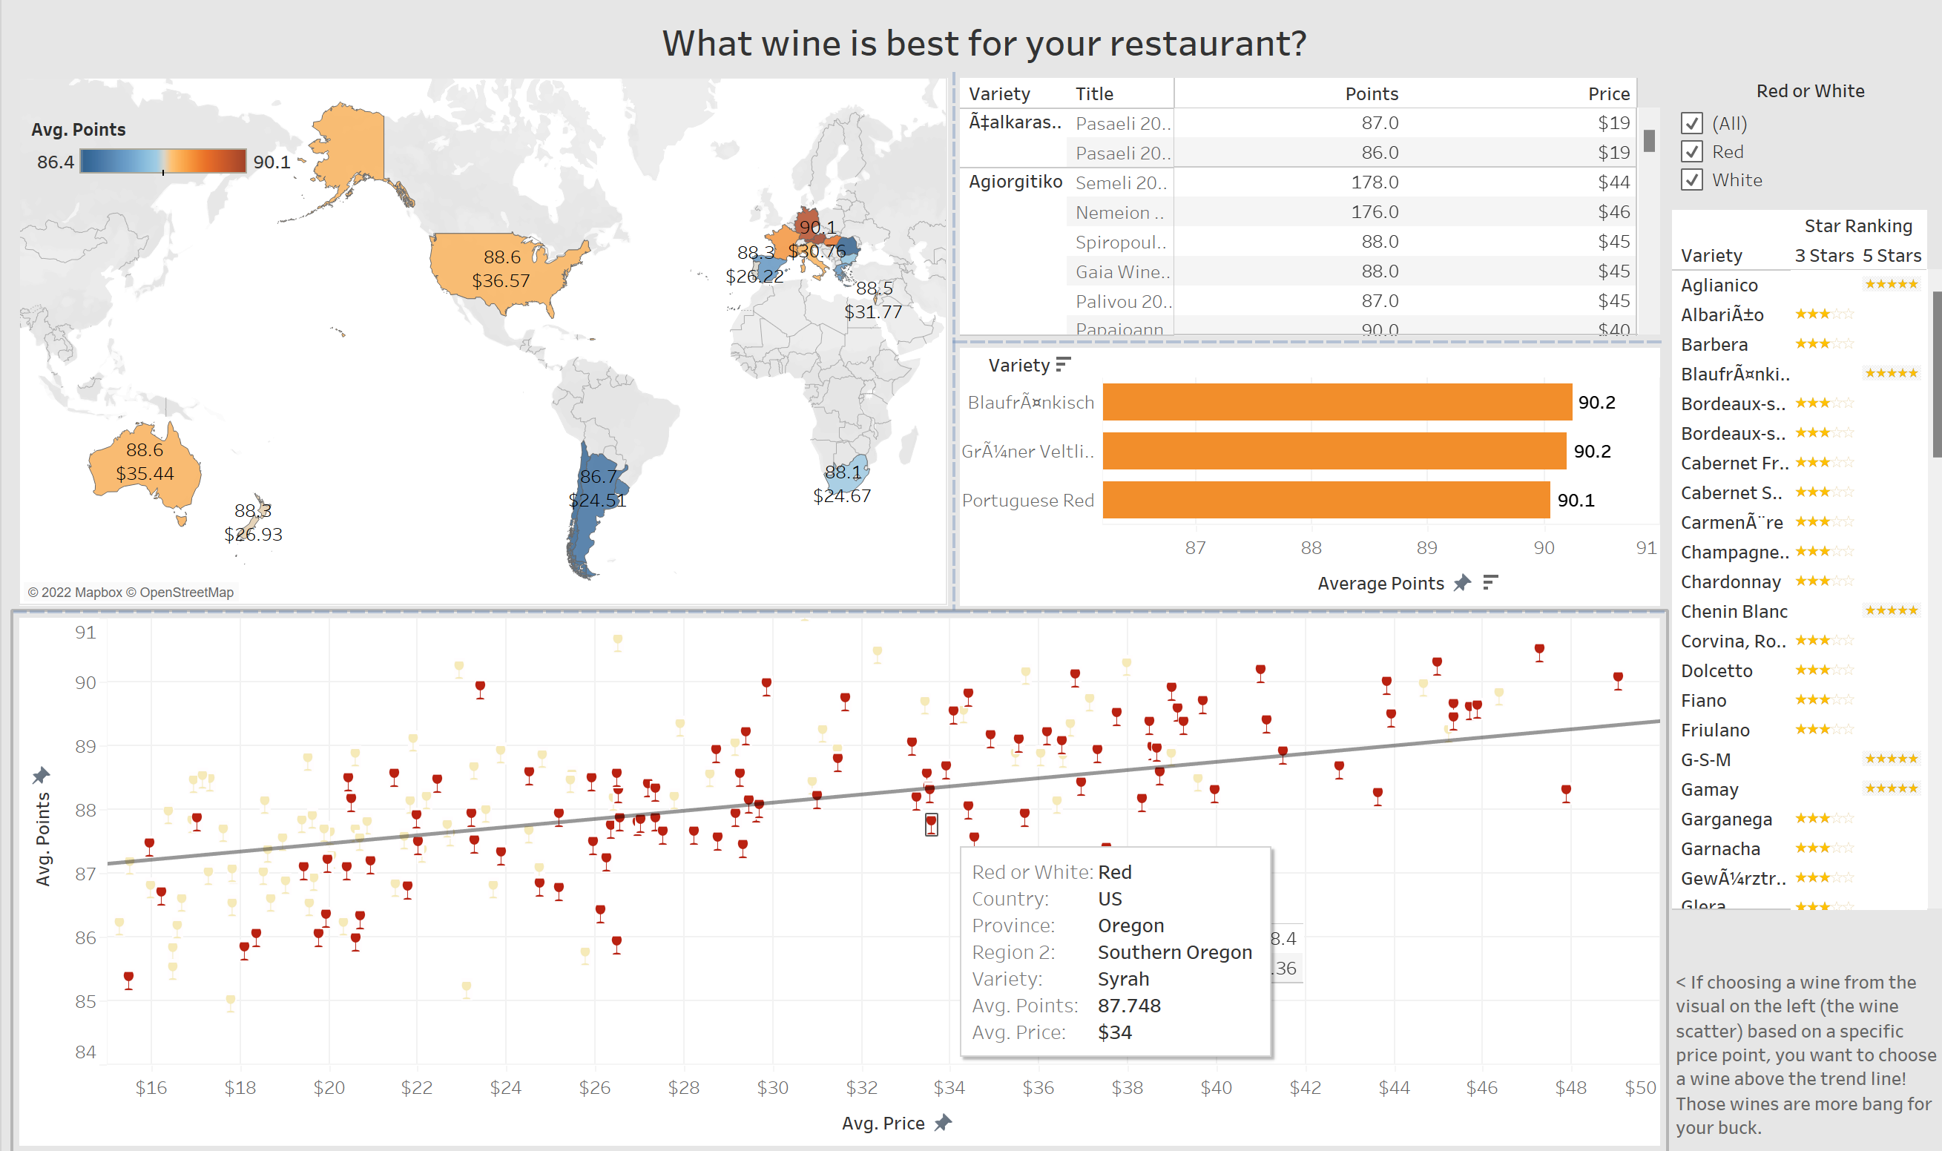
Keeping things simple and easy to understand Illustrative Examples
Horizontal Bars
Filter
Symbol Map
Text Table
Scatter Plot
Tooltip w/ Marks

Slide 10
Effectively including titles, labels, context Key Points
Titles signal and predict the content for users!
What does the audience want to see?
Think in terms of “as-is” or “cut to the chase” with titles and labels.
Appropriate titles and labels ground the data in a context!
How much should be contained in the titles and labels?
It depends, the descriptions of titles, subtitles, annotations, and labels should succinctly describe sheets and panes based on point #1.
Context is paramount for interpreting a data story!
How does context function within the realm of analytics?
It gives a reference point to draw meaningful conclusions about data patterns.
Bill Gates went so far as to write an essay in 1996 on the Microsoft website titled, “Content is king, but context is???”
Context gives us meaningfulness and relevance to understanding more than guess making of data patterns!
Analytics are an art of using techniques to describe and interpret information from data. If one can’t describe the picture with titles and labels, the propensity for erroneous interpretation increases.
Without context, establishing a connection with the audience will be about as effective as showing up at a formal ballroom event wearing a swimming suit while everyone else is wearing suits and evening dresses.
Typically, context is comprised of four ingredients:
Context of audience
Context of data
Context of presentation
Context of structure

Slide 11
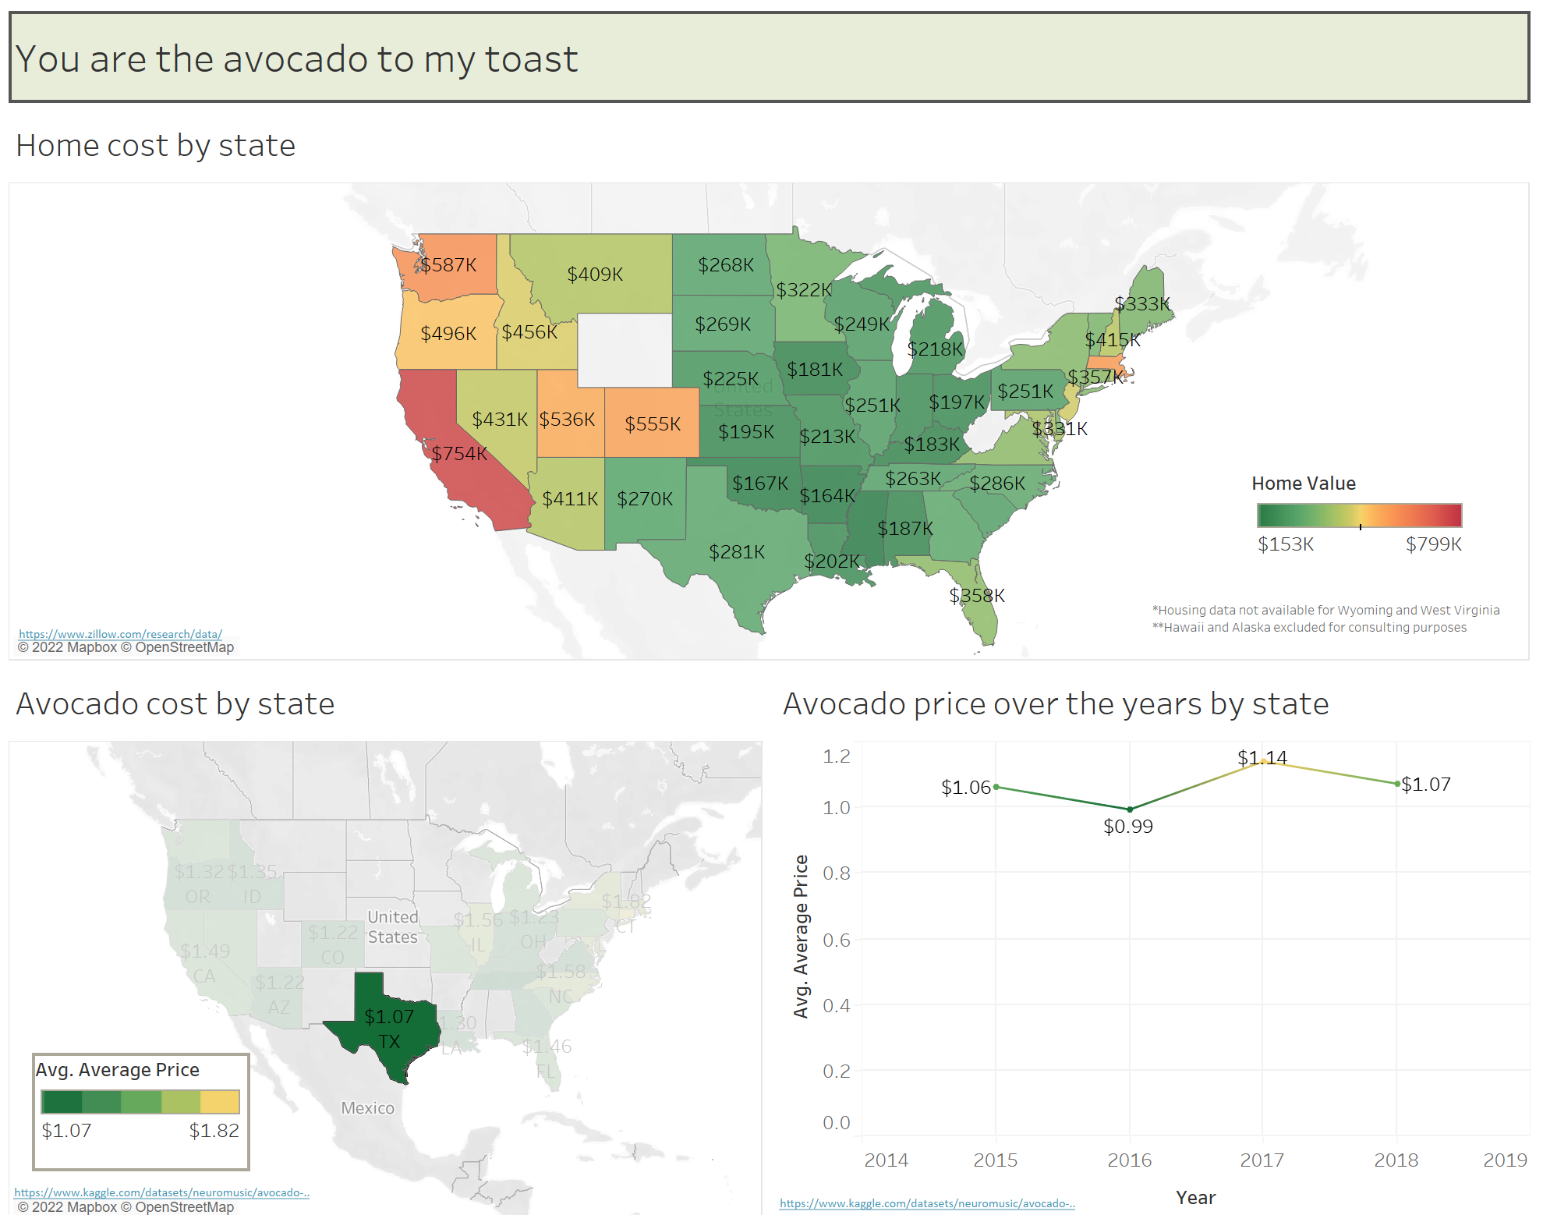
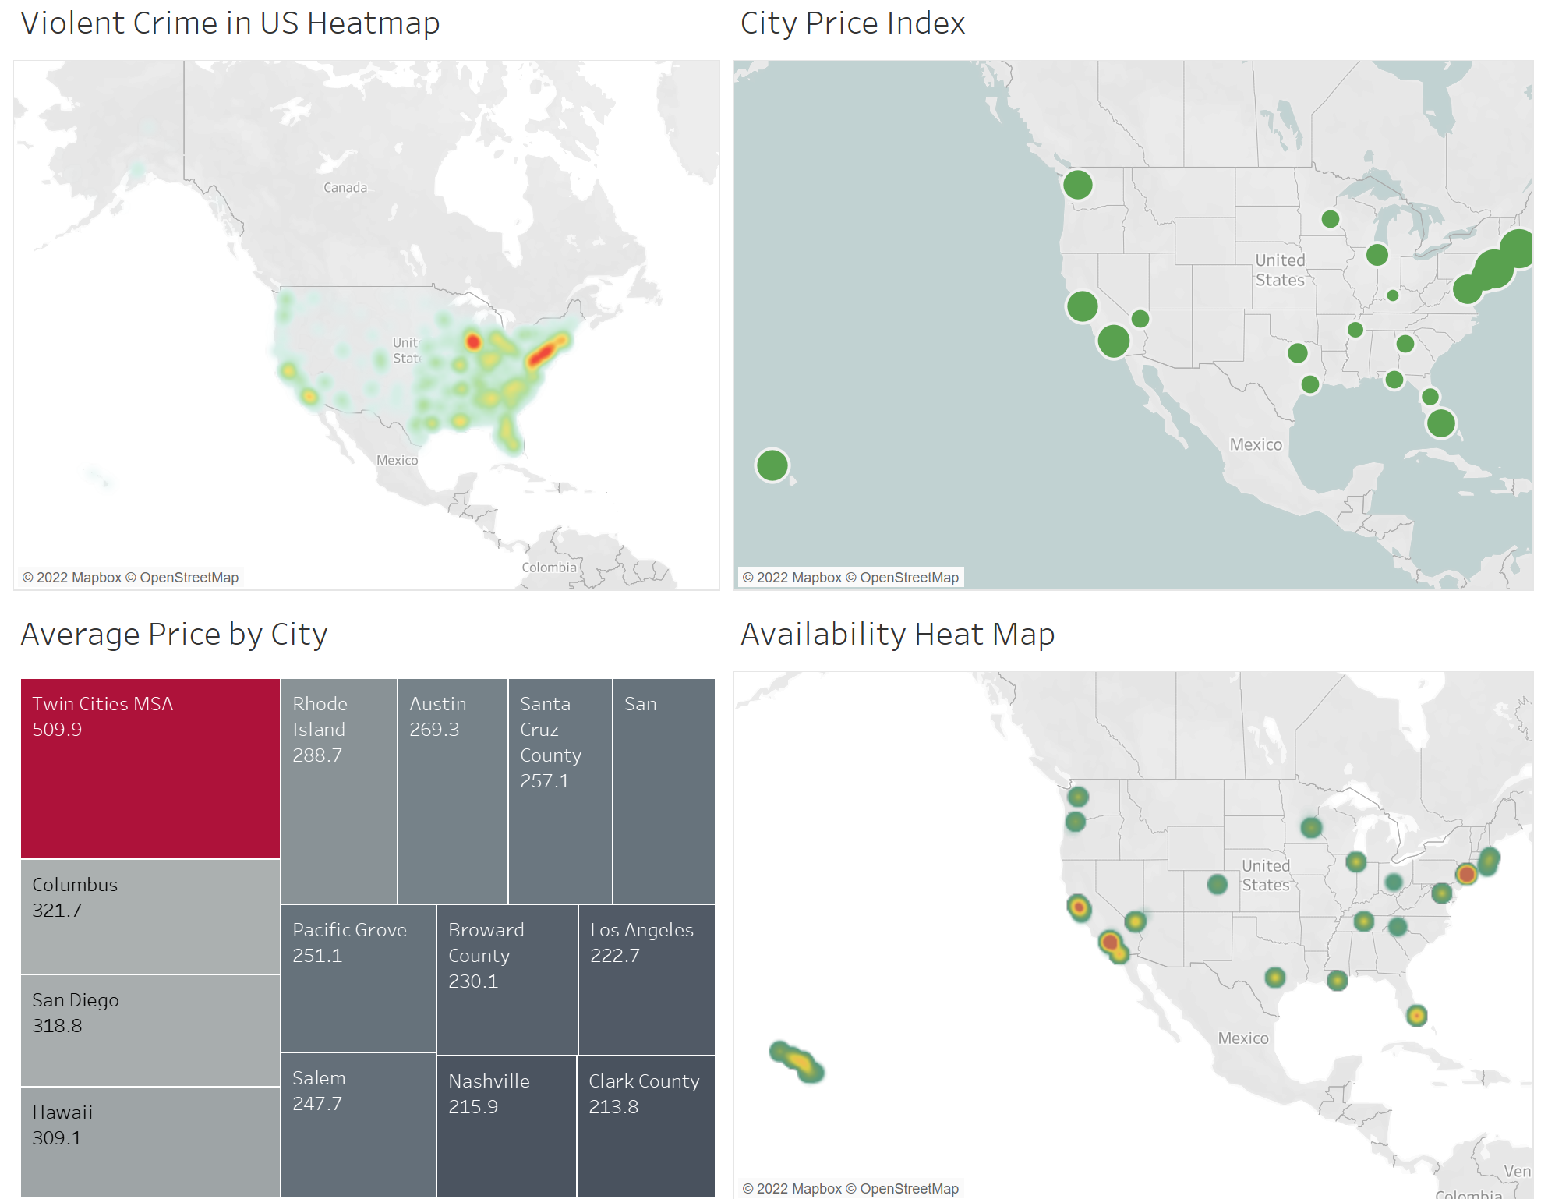
Effectively including titles, labels, context Illustrative Examples: “As-is”
Concept: Consultants hired to find the best place to purchase an AirBNB for investment purposes.
Concept: Consultants to help young couples who want to get married, buy a house and don’t live broke.
Careful usage of red
Suggestions:
Las Vegas, NV
Austin, TX
Nashville, TN
Suggestion:
Texas
Semi-saturated
Annotation?
Descriptive subtitles missing

Slide 12
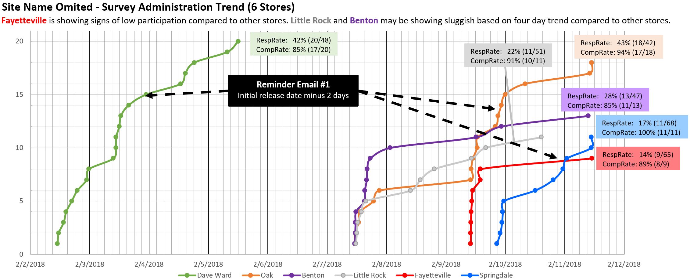
Effectively including titles, labels, context Illustrative Example 2: “Cut to the chase”
Study/Consulting Results
RespRate: 61% (197/321)
CompRate: 82% (161/197)

Slide 13
Utilizing interactive dashboards Key Points
Be intentional and effective when allowing users to filter, select, animate, and extract information!
When designing an organic dashboard, we guide the users to pertinent areas of interest.
Be purposeful when deciding to incorporate a particular dashboard. What value does it bring? If necessary, ask a colleague or manager’s opinion.
Incorporate a mix of exploratory, explanatory, and possibly (infographics) to be effective in conveying analytic results.
A mix is more likely to be dynamic for understanding the analytics, thus more immersive for users.
“Begin with the end in mind.”
– Stephen Covey
Analytics/Data Viz Translation:
Think of the user experience when designing and incorporating interactiveness in the dashboard!

Slide 14
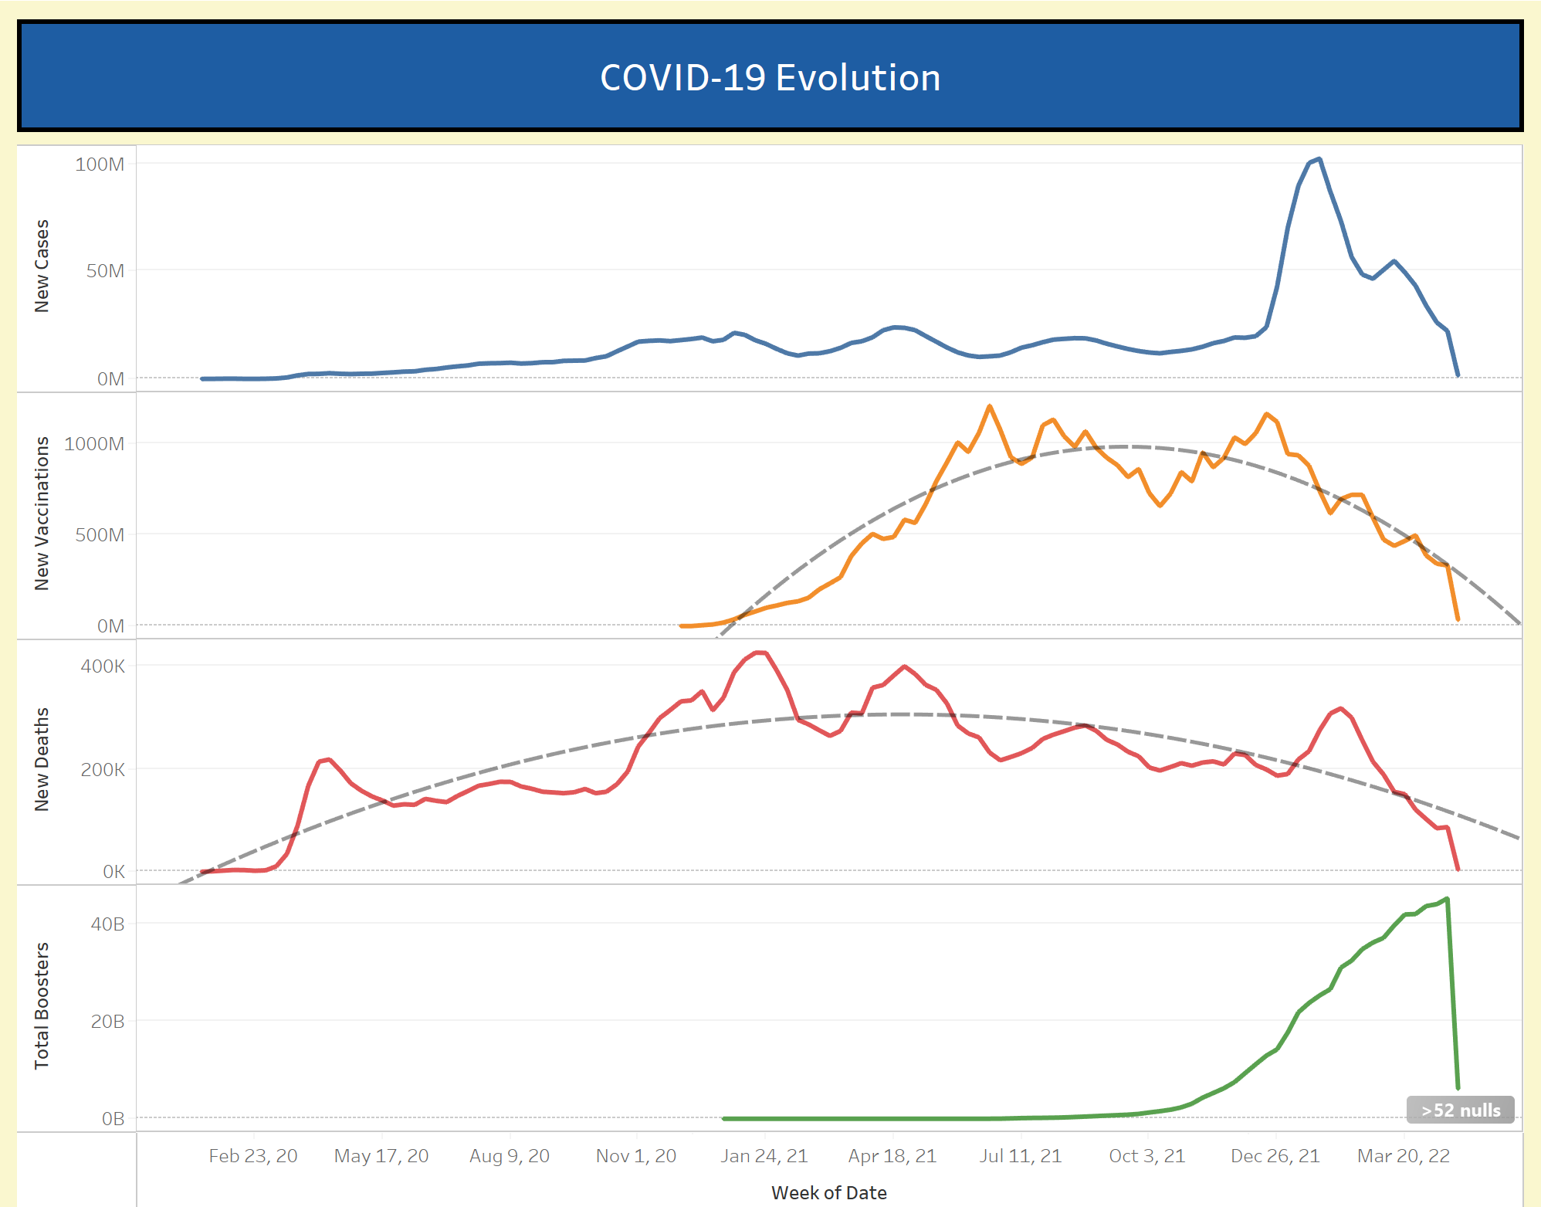
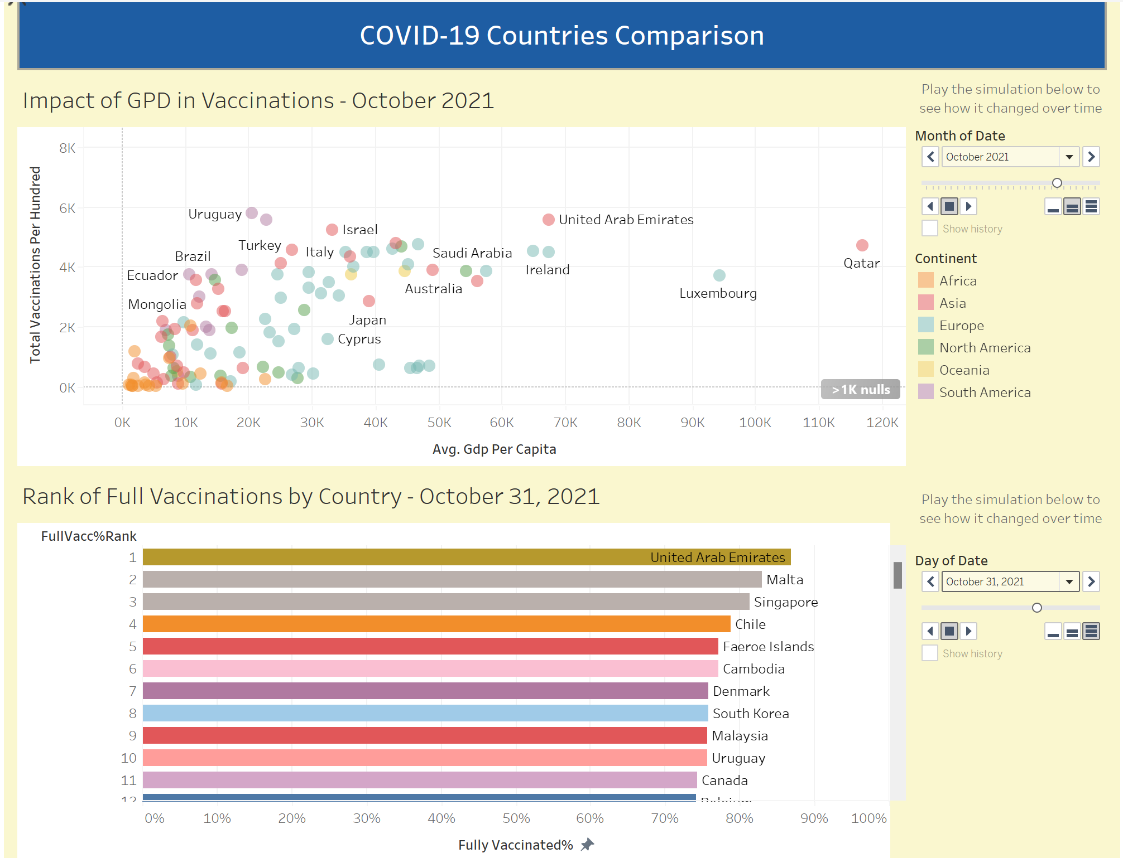
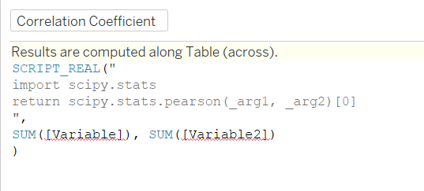
Utilizing interactive dashboards Illustrative Example 1
Usage of instructional labels
Trend annotation missing
Incorporate TabPy to leverage Python script
Interactive with animation

Slide 15
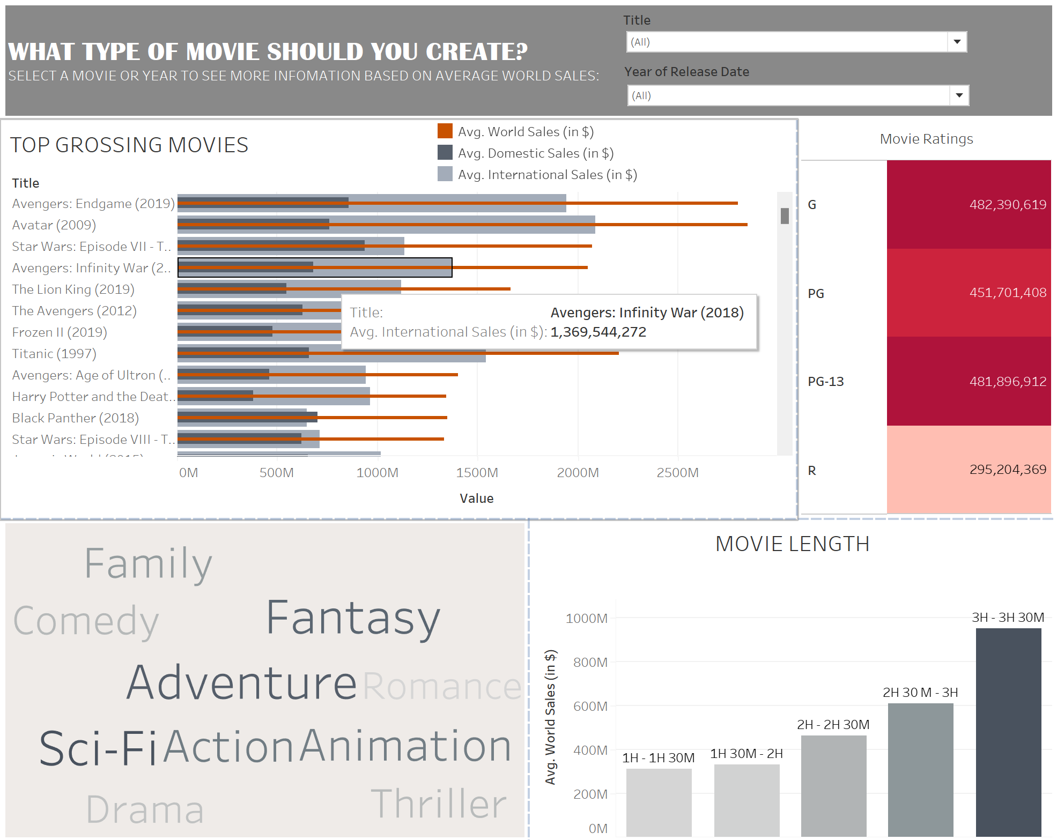
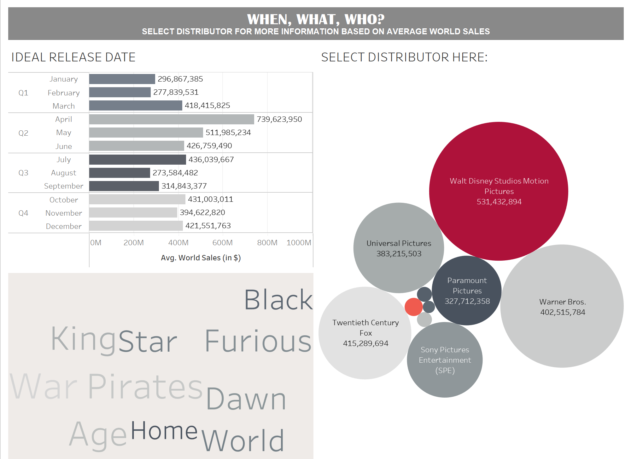
Utilizing interactive dashboards Illustrative Example 2
Interactive with choice selection
Conclusion and Recommendations
Trying to optimize movie sales?
Length: 3-hour to 3-hour 30 minutes
Genre: Adventure, Sci-Fi, Fantasy
Rating: G/ PG-13
Distributor: Walt Disney Studios Motion Pictures
Release Date: Quarter 2, April
Appropriate visualization of categorical and continuous data
Used descriptive titles and subtitles

Slide 16
Summary
High-level guidance within five topics was discussed and expanded upon by a few student project illustrations from my prior data visualization/analytics course offerings.
Audience/Needs, Appropriate Visualization, Interpretable Results, Labeling, and Interactive Dashboards are all part of an interconnected system that helps us understand the story of data analytics.
When performed well, regardless of the software (Excel, Tableau, Python, R, SPSS), the analytic techniques function similarly to an engine to solve and identify business problems.

